Slide 1
OA Welcome Session
<Insert Lodge Name Here>
Notes:
The slide notes have been included on each slide to provide for context and in some places direct wording to assist in delivering the content correctly and uniformly.
The italic wording is included to provide a background on the slide, the red text is intended to be directly spoken.

Slide 2
Welcome!
Notes:
Welcome to the OA Welcome Session. Tonight we are here for you, our newly elected and soon to be inducted members, and your parents, to provide the information you need to successfully become a full member in the Order of the Arrow, and most importantly answer any questions that you or your parents have. We have dedicated times in the session for any questions to be asked, so we will be sure to address every question you have.

Slide 3
Introduction of Key <Lodge/Chapter> Administration
Lodge Chief - <Insert Lodge Chief name>
<Insert additional Lodge/Chapter youth>
Lodge Adviser - <Insert Lodge Adviser name>
<Insert additional Lodge/Chapter advisers>
<Insert Lodge Picture>
Notes:
Welcome and Introduction - This section entails the youth leader running the program welcoming the parents and thanking them for attending, as well as sharing a little about themselves and any other Arrowmen running the orientation.
The Order of the Arrow is a Youth Led organization, with the supervision and support of our wonderful adult, similar to your troops, crews, or ships that you are a part of. I’d like to take a second to introduce your leadership that are here to help you along the path to join the organization that we love so much.
<Introduce the Youth Officers/Chairmen and key Adults in attendance>

Slide 4
Important Information
My Lodge Name is <Lodge Name>.
My Chapter is <Chapter Name>.
My Chapter Meets at <Chapter Meeting Info>.
My Ordeal Date is <Ordeal Date>.
My Ordeal is going to be at <Ordeal Location>.
You may consider writing this information down.
<Lodge Logo>
Notes:
Important Information - This section is very important for the knowledge of parents. The presenter will want to make sure that each parent writes this information down or pre-printed for them. It includes basic information such as their (Child’s) lodge and chapter name, as well options to choose from regarding Ordeal dates/location. The presenter will want to be sure that each parent has chosen a date or registered for their child’s induction before leaving the meeting.
We have some important information that we want to ensure you have. If you have the ability, write this information down. <review all information, and explain significance>

Slide 5
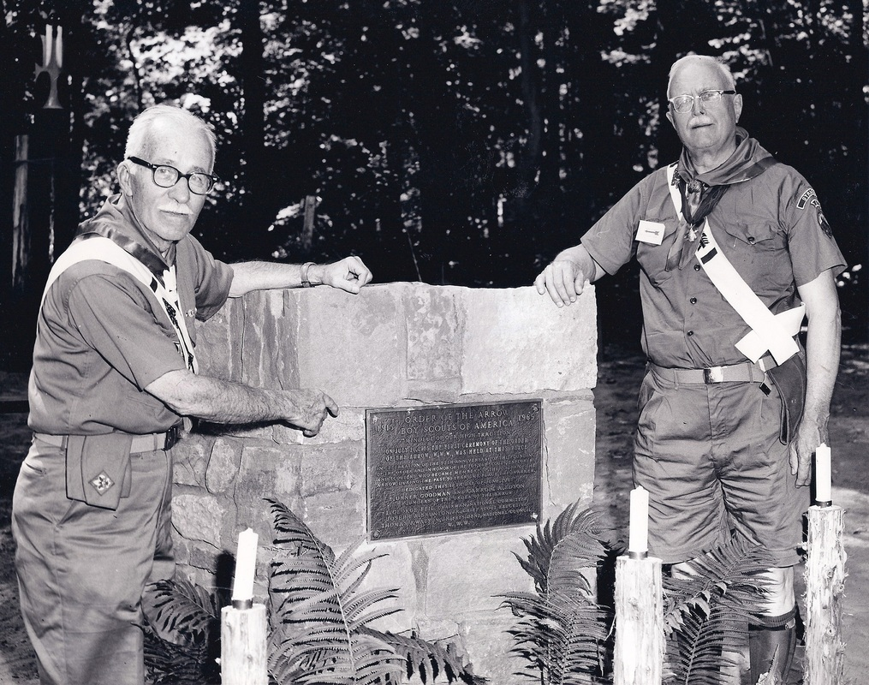
Background of the Order of the Arrow
Founded in 1915 by E. Urner Goodman and Carroll A. Edson
1934: Part of the National Boy Scout program
1948: recognized as the BSA’s national brotherhood of honor campers
Conservation, high adventure, and servant-leadership as main pillars of the program.
Notes:
Background of the Order of The Arrow - This section provides great insight regarding the founding of our organization, and how we have achieved success for over a century. The presenter should not bore them to death will 1,000 dates and stories, but simply give a quick synopsis of our key history as an organization.
The Order of the Arrow was founded in 1915 by Camp Director E. Urner Goodman and Assistant Camp Director Carroll A. Edson as a way to recognize select campers for cheerful service. The OA became part of the National Boy Scout program in 1934 and was officially recognized as the BSA’s national brotherhood of honor campers in 1948. The program has and continues to evolve in the areas of conservation, high adventure, servant-leadership and continues to grow and adapt to ensure the program is relevant and supportive of today’s youth.

Slide 6
Mission of the Order of the Arrow
The mission of the Order of the Arrow is to fulfill its purpose as an integral part of the Boy Scouts of America through positive youth leadership under the guidance of selected capable adults.
Notes:
Mission of the Order of the Arrow - Simply read the mission of the OA, and answer any questions that might come up.
The OA has a Mission, which is to fulfill its purpose as an integral part of the Boy Scouts of America through positive youth leadership under the guidance of selected capable adults. As you can see, we are a youth leadership program. We provide youth with the opportunity to grow and succeed in their own way through many different parts of our program available to them, with the adults on the sideline ready to support and guide as needed.

Slide 7
Purpose of the Order of the Arrow
As Scouting’s National Honor Society, our purpose is to:
Recognize those who best exemplify the Scout Oath and Law in their daily lives and through that recognition cause others to conduct themselves in a way that warrants similar recognition.
Promote camping, responsible outdoor adventure, and environmental stewardship as essential components of every Scout’s experience, in the unit, year-round, and in summer camp.
Develop leaders with the willingness, character, spirit and ability to advance the activities of their units, our Brotherhood, Scouting, and ultimately our nation.
Crystallize the Scout habit of helpfulness into a life purpose of leadership in cheerful service to others.
Notes:
Purpose of the Order of the Arrow - Simply read the purpose of the OA, and answer any questions that might come up.
Now, how do we do this? Our purpose provides us the answer.
As Scouting’s National Honor Society, our purpose is to:
Recognize those who best exemplify the Scout Oath and Law in their daily lives and through that recognition cause others to conduct themselves in a way that warrants similar recognition.
Promote camping, responsible outdoor adventure, and environmental stewardship as essential components of every Scout’s experience, in the unit, year-round, and in summer camp.
Develop leaders with the willingness, character, spirit and ability to advance the activities of their units, our Brotherhood, Scouting, and ultimately our nation.
Crystallize the Scout habit of helpfulness into a life purpose of leadership in cheerful service to others.

Slide 8
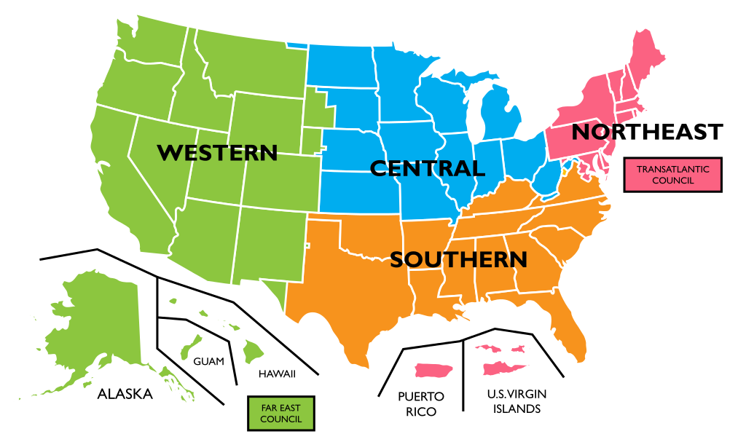
Contemporary Order of the Arrow
266 lodges - 45 sections - 4 regions
Open to all Scouting programs (Scouts BSA Troop, Sea Scout Ships, Venturing Crews)
Leadership positions and voting rights for under 21.
Brotherhood, Cheerfulness, and Service
Leadership and Character Development
Notes:
Contemporary Order of The Arrow - This section provides great insight regarding how the Order of The Arrow benefits youth as an organization. It should be highly emphasized that we are a leadership development organization, and wish to see our members continue to develop those skills beyond their induction. We want parents to understand that our goal is to build their Scout into a better person and leader, which will help their unit, chapter, and lodge thrive.
Presently, the Order of the Arrow consists of nearly 300 lodges, which form 45 sections in four regions, and each of those lodges have leadership positions and voting rights that are restricted to members under the age of 21. There members come from all Scouting Programs that meet the minimum age requirement, including Scouts BSA Troops, Sea Scout Ships, and Venturing Crews.
Through the program, members live up to the ideals of brotherhood, cheerfulness, and service set forth by E. Urner Goodman and Carroll A. Edson. Our entire organization thrives on these three words as the guiding force. To accomplish a Brotherhood of Cheerful Service, we have adapted into a Leadership and Character Development Organization allowing Arrowmen to get involved in areas that they excel.

Slide 9
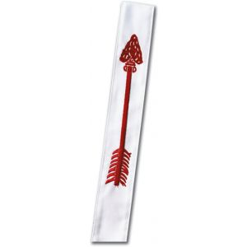
The Honors
Induction - called the Ordeal Honor.
4 challenges of the Ordeal:
Scant Food
Silent Thought
Night Alone
Arduous Labor (Service)
Notes:
The Honor’s - This section talks about the different honors in our organization, the Ordeal (Induction), Brotherhood, and Vigil. It breaks each one down, and works through how each are obtained or earned, and the requirements associated with each.
Similar to ranks in your Scouting Units, the Order of the Arrow has similar stepping stones that we use. Over the next three slides, we are going to talk about each of these three, the Ordeal, Brotherhood, and Vigil.
The Ordeal, what you’re currently preparing to go through, is the first honor. After being elected, candidates, that’s you, will go through a ceremony where your next day is explained. During the Ordeal process, candidates are put through challenges of maintaining silence, receiving small amounts of food, working on camp improvement projects, and sleeping apart from other campers. These experiences are designed to teach the values our organization strives to instill in experiential ways.
All candidates for membership must complete an ordeal to become a member of our organization.

Slide 10
The Honors, cont.
Brotherhood
6 months of service as an Ordeal member
Notes:
The Brotherhood Honor is second honor and requires a minimum of 10 months of membership as an ordeal member and other requirements. Obtaining this honor places further emphasis on the ideals of Scouting and the Order.
The Brotherhood Honor is something the Ordeal member works for on their own, it is there responsibility and sole ability to receive the honor and earn their bars.

Slide 11
The Honors, cont.
Vigil
Minimum of two years as Brotherhood
Distinguished contributions to their lodge, the Order of the Arrow, Scouting, or their Scout camp
Bestowed by special selection
Limited to one person for every 50 members
Notes:
After two years of exceptional service as a Brotherhood member, a Scout or Scouter may be recognized with the Vigil Honor for their distinguished contributions to their lodge, the Order of the Arrow, Scouting, or their Scout camp. This honor is bestowed by special selection and is limited to one person for every 50 members registered with the lodge each year.

Slide 12
My Story
by <insert name here>
Notes:
My Story - This section showcases the youth representative running the orientation providing their own personal story about what the Order of The Arrow means to them. What made them get involved? How has the Order of the Arrow benefited your career outside of Scouting? What skills has the organization provided you that you couldn’t earn anywhere else? The story should be inspiring and really work to build a relatable connection with the candidates present.

Slide 13
What Can I Do In The Order of the Arrow?
Local
Camp Service
Promoting Camping
Lodge Fellowships
Lodge Leadership
Brotherhood
Chapter/Lodge Meetings
National
National Order of the Arrow Conference (NOAC)
National Leadership Seminar
OA High Adventure
Section Conclave
Notes:
What can I do in the Order of The Arrow? - This section has 2 unique parts to it - both local and national opportunities. The local opportunities should include the activation event, which is an event held within 6 months (but preferably within 90 days) following an induction weekend with the intent to involve new members, encourage retention at the local level, build personal growth, and ensure future involvement in the OA, as well as local leadership and service opportunities, such as chapter or lodge meetings. The national opportunities should include the National Order of The Arrow Conference (NOAC), National Leadership Seminar (NLS), Order of The Arrow High Adventure (OAHA), and Section Conclave. Handouts are available on the national website, and it is recommended that information on these opportunities is handed out for the parent to take home and review.
<Insure that you add special mention to the specific things they can get involved with associated to your lodge>

Slide 14
Candidate
Question & Answer Session
with the exception of questions about the induction process
Notes:
Candidate Question and Answer Session - This section should give candidates an opportunity to engage in conversation regarding any questions they have about the OA or its opportunities. In should be emphasised that this section is only permitted for candidates to answer.

Slide 15
Breakout
Notes:
Breakout - During this section, it is best if the candidates are led by another pair of youth Arrowmen in attendance in team building activities. It should create a friendly, learning environment where candidates can feel comfortable by enjoying a time of fellowship and brotherhood.

Slide 16
Induction Process Walkthrough
Notes:
Induction Process Walkthrough - This section will take place simultaneously with the candidate breakout, and should provide an in depth synopsis of what candidates will experience throughout the induction weekend, highlighting the engaging opportunities that follow.
During this session, walk the parents through the basics of the ordeal process and ensure you hit on the four challenges. You will want to use some discretion to ensure they will also have a meaningful experience if they ever go through, but ensure any fears related to the Ordeal are addressed.

Slide 17
Parent Question & Answer
Session
Notes:
Parent Question and Answer Session - This section will take place simultaneously with the candidate breakout, and should provide an opportunity for parents to engage in a conversation regarding any questions that have about the OA, including its induction process, leadership opportunities, time commitment, etc. Some examples of the types of questions that may be asked along with suitable responses are as follows:
Q: “Will my child get to eat during the induction? I’ve heard rumors that they are essentially starved throughout the weekend.”
A: Yes of course. The Ordeal includes a challenge of scant food which highlights the symbolism of self denial, but by no means are they starved or left to go hungry.
Q: “What benefits will my child receive by completing their induction?”
A: The benefits are endless. From being provided opportunities that will work to develop their leadership skills in Scouting and beyond, as well as provide an emphasis on unit involvement, whether that’s simply attending meetings, or earning the rank of Eagle Scout or Summit Award, or Quartermaster Award.
Q: “How much money will I have to commit to the organization?”
A: This question varies by lodge, but ensure that you provide them the truth while making sure to address the expenses associated with each item, and the reasoning behind the cost.
Q: “How much of my child’s time will this take? They are already very busy.”
A: Your child’s involvement can vary based on how involved the want to be. They can attend basic events (fellowships and inductions) as a part of the organization, or they can become very involved and attend other meetings, planning conferences, national events, and so much more.
Q: “Can I attend any of the events with my child? I’d like to see them get their ordeal or brotherhood.”
A: Nothing in our organization is a secret, however, we highly encourage you to consider allowing your child to do this on their own. This allows them to have this experience, as every other candidate has, as well as allows you the anonymity in the future if you ever become a member of our organization.

Slide 18
Welcome Back Candidates!
Notes:
Welcome Back Candidates! - This section should welcome candidates back into the room where the parents are meeting with the lodge leadership. It would be beneficial to ask a few candidates to stand and share what they enjoyed about the team building activity with the group. This will showcase to parents right off the bat that the OA’s leadership is engaging and fun!

Slide 19
Notes:
Play Video Interviewing Youth & Adult Arrowmen About the Order’s Impact - This section is very unique and will resonate closely with parents. It showcases a video where youth & adult Arrowmen are interviewed, answering questions about what the Order of the Arrow has done for their life. It highlights the opportunities they will receive beyond the OA, and how the organization prepared them for life.

Slide 20
Thanks for coming!
Contact Us @ <Contact Info> with any questions.
Lodge Website - <LodgeWebsite>
National Website - oa-bsa.org
Notes:
Thanks For Coming! - This section should provide a very brief thank you to the parents from the leadership running the orientation program. It should again be emphasized that an induction date must be picked, as well as the activation event date and first eligible brotherhood opportunity should be added to their personal calendars. Parents should also be provided necessary contact information for lodge leadership, as well as online sources such as the lodge and OA websites.

